Slide 1
Welcome to Hack Darul Islah 2026!
Darul Islah / 2026 / September 5-6
Hack Darul Islah 2026

Slide 2
Agenda
Day 1 — 9/5/26
8:00 AM – 9:00 AM: Registration & Check-in
9:00 AM – 9:15 AM: Opening Ceremony
9:30 AM: Coding Begins
10:00 AM – 11:00 AM: Building Apps with AI
12:00 PM – 1:00 PM: Lunch
1:15 PM: Dhuhr Prayer
2:45 PM – 3:30 PM: Passing the Technical Interview
4:30 PM – 5:15 PM: Ummah Professionals Panel
6:00 PM: Asr Prayer
6:30 PM: Dinner
7:30 PM: Maghrib Prayer
9:00 PM: Isha Prayer & Khatirah
12:00 AM: Midnight Games
Day 2 — 9/6/26
5:45 AM: Fajr Prayer
7:00 AM: Breakfast
9:00 AM: Project Submission Deadline
9:00 AM – 12:00 PM: Presentations & Judging
12:00 PM: Awards & Closing Ceremony

Slide 3
Housekeeping Rules
Please move your car to the satellite lot at the earliest convenience.
Please be respectful of the masjid
Please clean up after yourself and leave the masjid as you found it or better
Respect other people’s spaces, there’s plenty of room for everyone to work
Women’s bathroom is to the right of the stage, men’s room across from it
Attending salah is mandatory for those required to pray

Slide 4
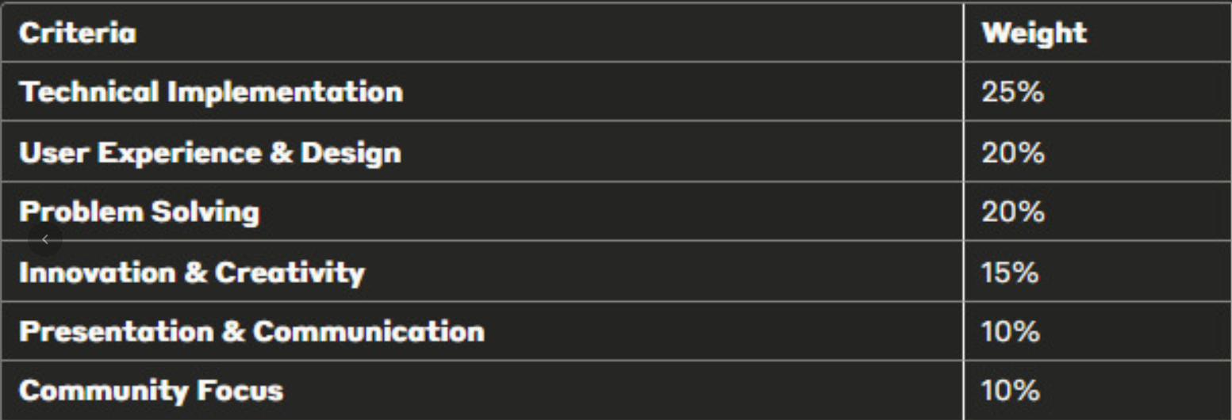
Format
All projects must be submitted before 9 AM on Sunday (github and presentation)
Rubric
Judging will be based on the challenge statement, but you can build anything
Any sort of software application (mobile, native, web) is allowed.
AI assistance within your development environment is allowed, but full app/site builders e.g. replit or v0 are not.
Link to format for presentation provided in links document

Slide 5
The Challenge: Building the Connected Ummah
Challenge Statement
The Problem
Despite being united by shared faith and values, our local and global communities often experience deep fragmentation. Individuals, Muslim-owned businesses, community organizations, and religious institutions frequently operate in silos. This disconnect makes it difficult for individuals to find community spaces, for institutions to engage their congregations, and for people to discover and support Muslim professionals and enterprises.
The Challenge
Your mission is to design and develop a tech-driven solution—whether it is a web platform, mobile app, or community tool—that breaks down these silos and builds a cohesive, interconnected Muslim ecosystem. We are looking for innovative ways to bridge the gap between people, places, and services.
Peer-to-Peer (Muslims to Muslims): Build something that helps individuals find their people. This is wide open! It could be a platform for organizing local Quran study groups, a directory for finding Muslim roommates, tools for building community "third spaces," or interest-based networks (e.g., Muslim hikers, techies, or creatives).
Civic & Institutional (Muslims to Institutions): Build something that modernizes how we interact with our organizations. How can we improve communication, volunteer matching, or resource sharing between individuals and their local masjids, schools, or Islamic nonprofits?
Economic & Professional (Muslims to Businesses): Build something that circulates resources within the community. Create tools that make it seamless to discover, review, and support Muslim-owned local businesses, halal services, or professional networks (e.g., Muslim therapists, lawyers, or contractors).

Slide 6
Pw: DISchools@07666
SSID: DI-Schools

